Slide 1
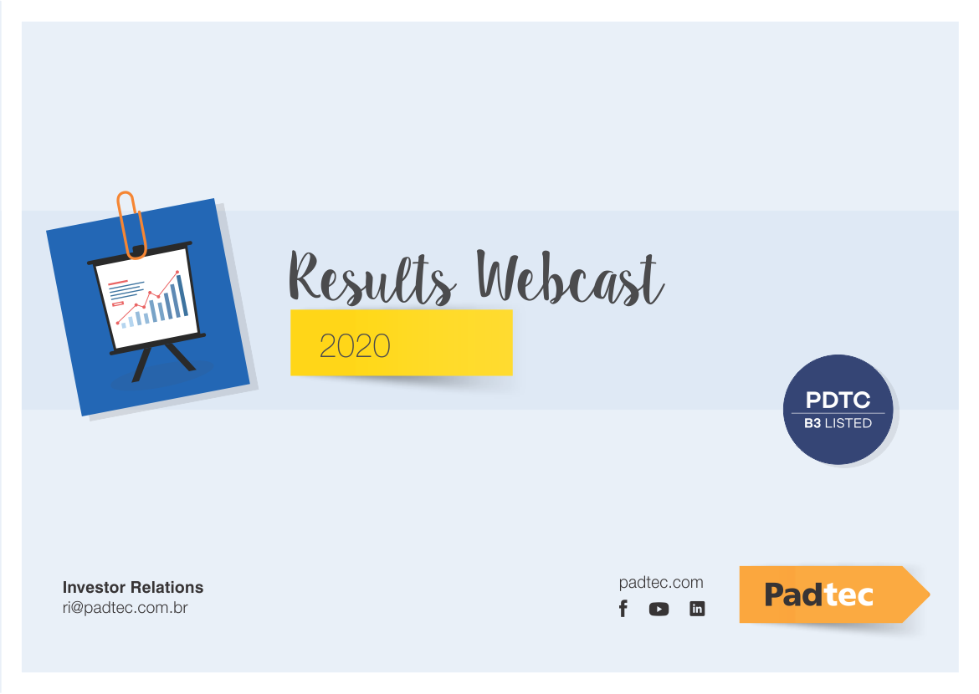

Slide 2





Why we exist
Make quality internet accessible for everyone by increasing fiber capacity
Help clients build their own optical fiber infrastructure
Support Brazil and CALA’s massive data traffic increase
Transfer and store data along the longest distances

Slide 3
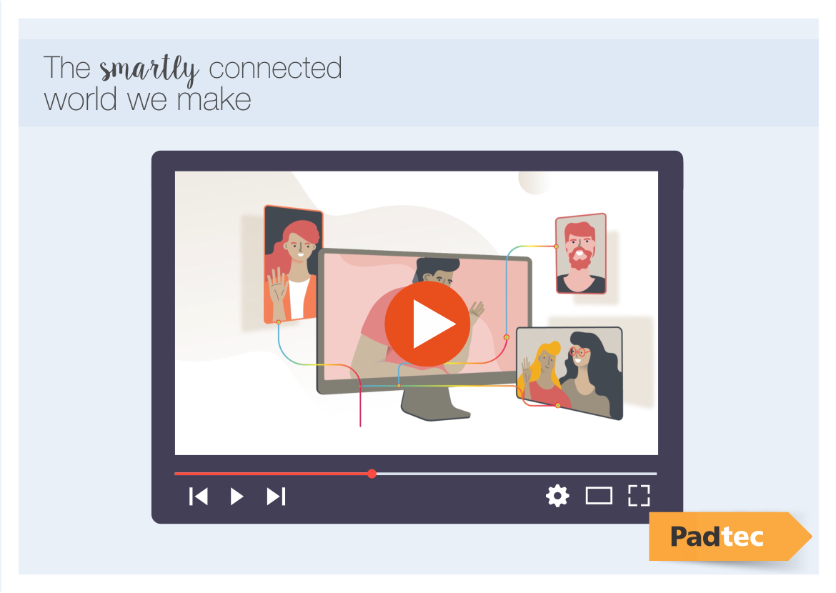
O mundo inteligentemente conectado que nós fazemos

Slide 4

What is our role in this ecosystem?
Padtec: the connectivity enabler in a booming market with a unique value preposition
Broadband Connections in Brazil per Speed
customers are Demanding Higher Broadband Speeds…
< 12Mbps
12Mbps - 34Mbps
> 34Mbps
We operate behind the lines as a connectivity enabler
Sep-20
…and in order to transmit more bits through the impressive fiber networks:…
Brazil Fixed Broadband Subscribers Evolution (mm)
CAGR _{'14-'19}
6.6%
Sole LatAm native Transmission network equipment providers
0.0%
53.4%
…DWDM is the key equipment to achieve that
Most cost effective and scalable way to increase fiber capacity
(vs. investing in new pair of fiber optical cables
Sources: Companhia, Cisco, Anatel

Slide 5




Ready to seize opportunities risen from 5G
5G could trigger a new CapEx cycle for telcos, reaching ~US$15.5bn in LatAm
It will require large bandwidth of new spectrum, surpassing all past generations by four-fold
Padtec’s equipment will be indispensable to ease both CapEx and OpEx for these cos.

Slide 6
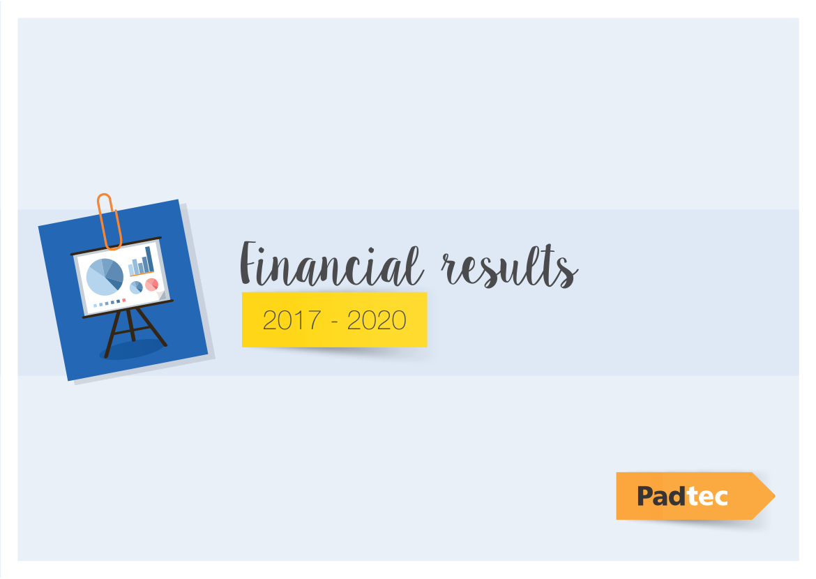

Slide 7
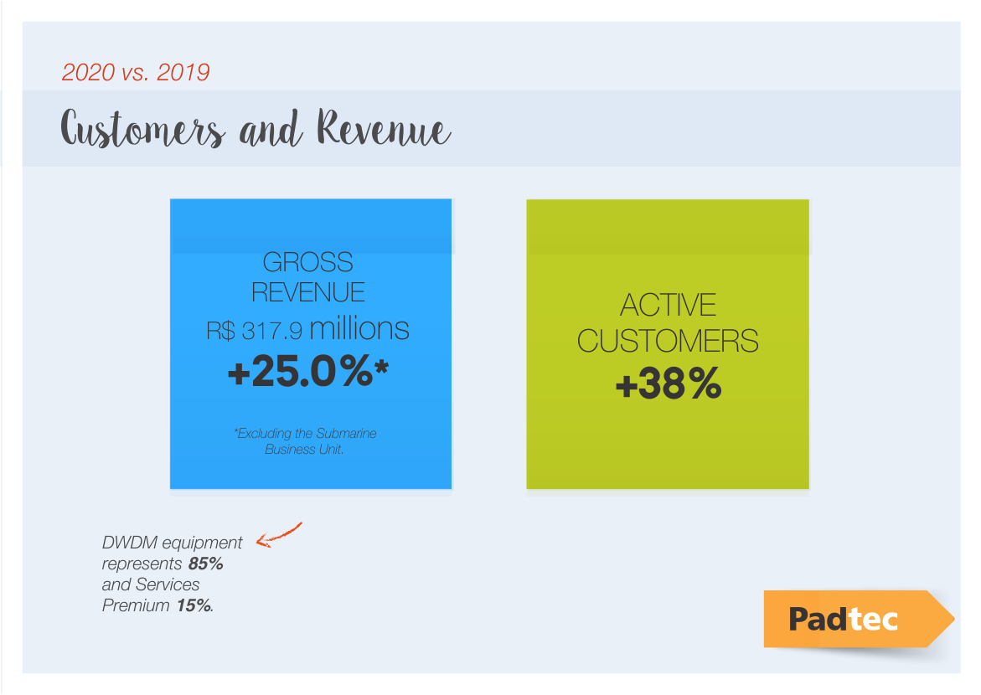

Slide 8
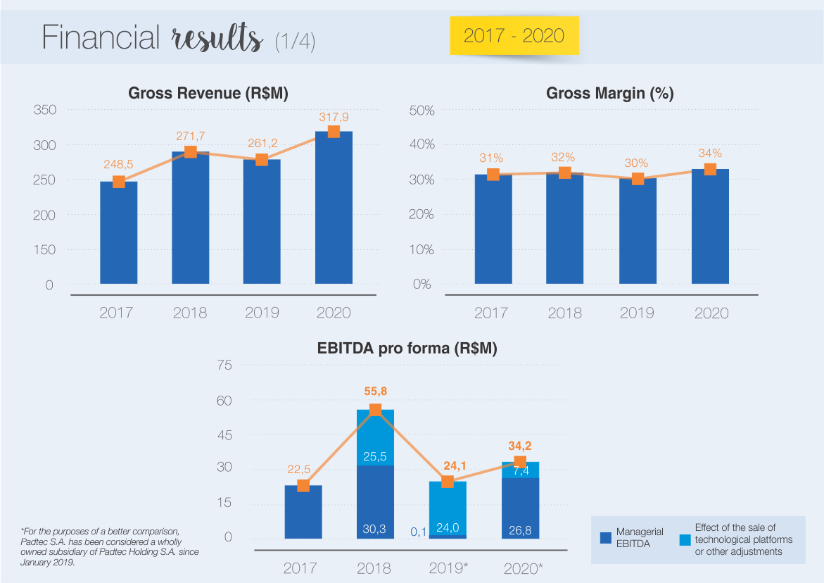

Slide 9
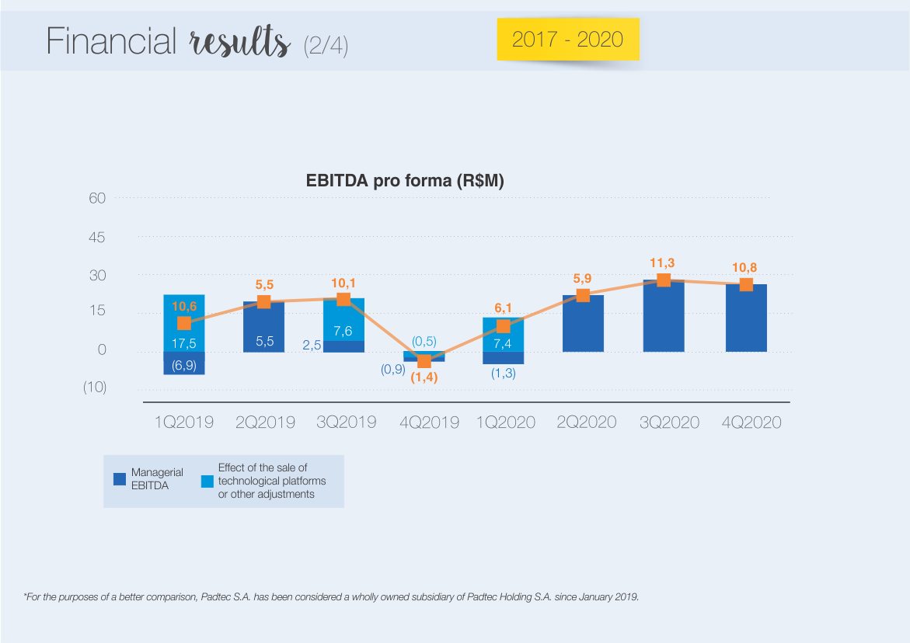

Slide 10
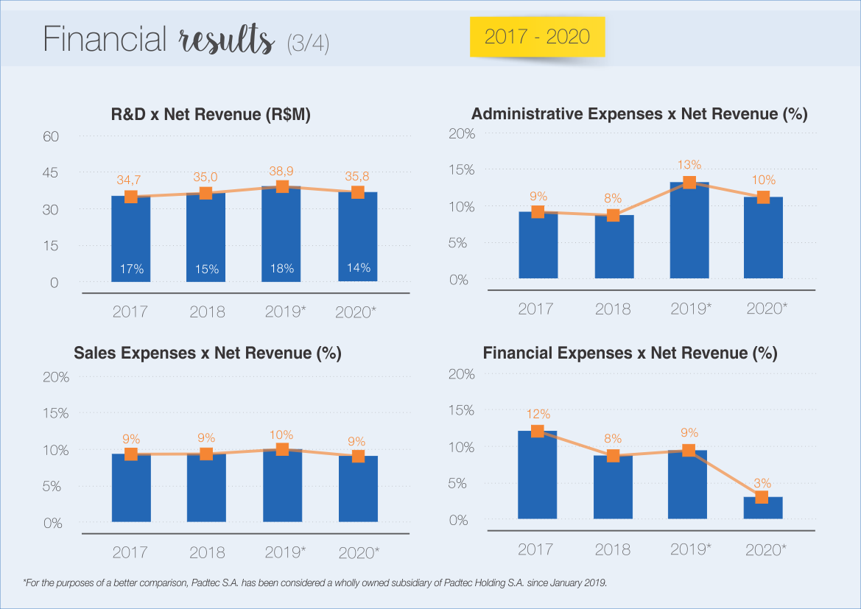

Slide 11
