Slide 2
Disclaimer
This material may contain projections and/or estimates of future events. The use of the terms "anticipates", "believes", "expects", "estimates", "plans", "anticipates", "projects", among others, is intended to signal possible trends and statements that evidently involve uncertainties and risks, and future results may differ from current expectations. Forward-looking statements are based on a variety of assumptions and factors, including economic, market and industry conditions, as well as operational factors.
Any changes in these assumptions and factors could lead to practical results that differ from current expectations. These forward-looking statements should not be fully relied upon. Forward-looking statements reflect only opinions as of the date they were made and presented.
The Company is not required to update them in the light of new information or new developments. The Company is not responsible for transactions that are carried out or for investment decisions that are made based on these projections and estimates. Finally, the pro forma financial information contained in this material is unaudited and, therefore, may differ from the final audited results.

Slide 4
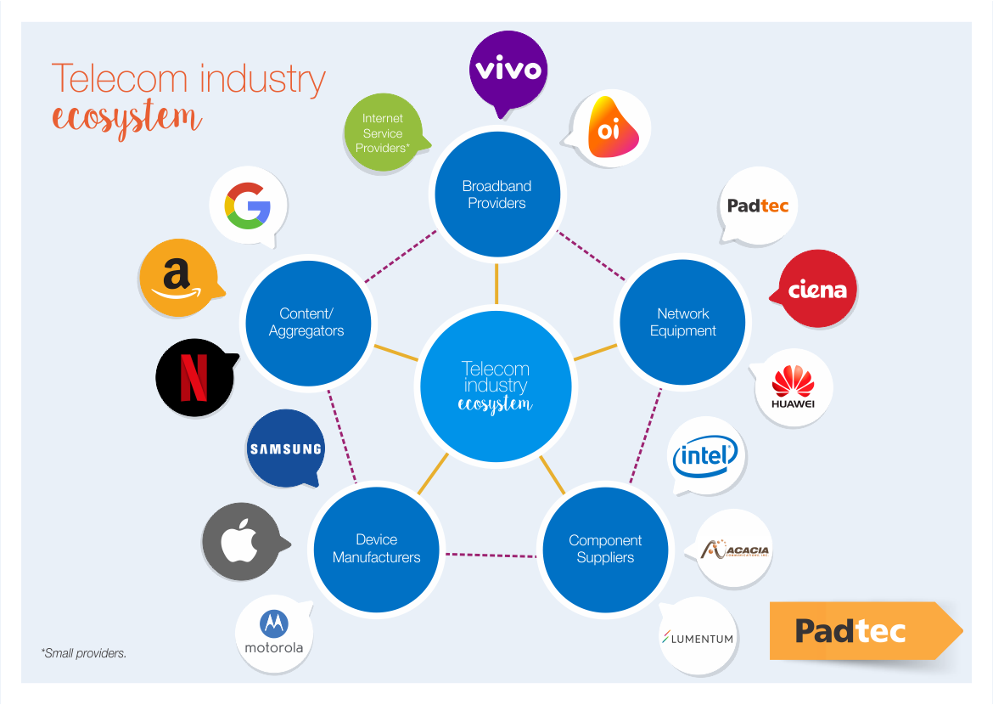

Slide 5
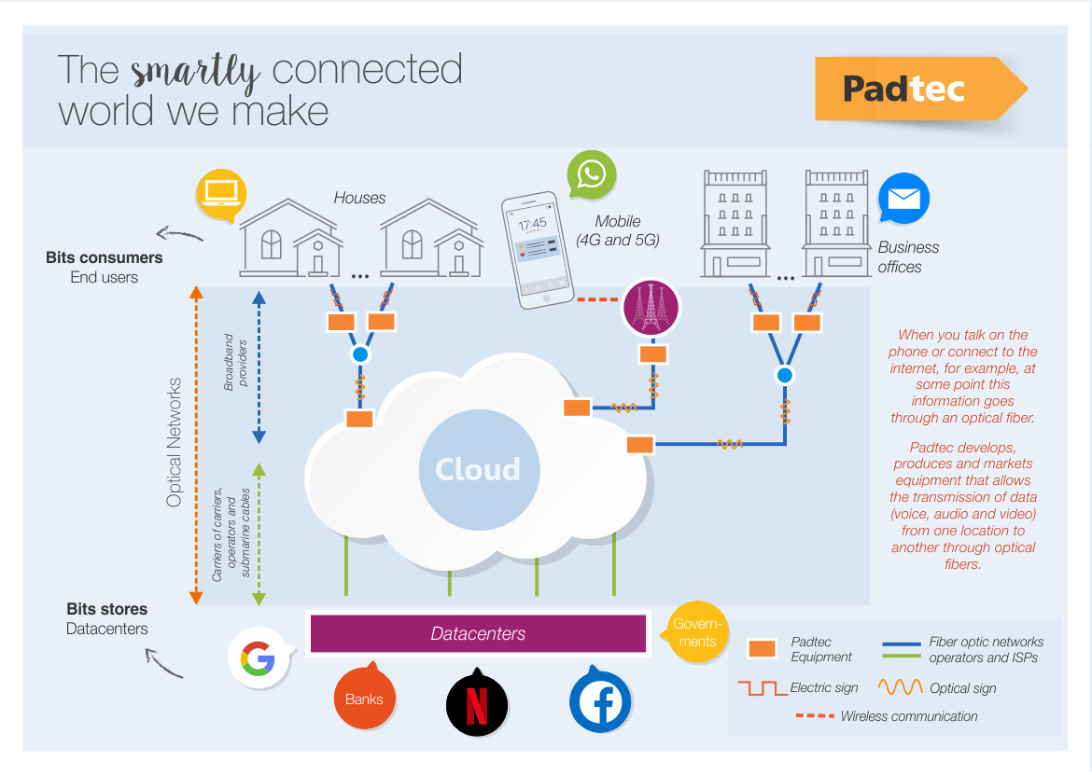

Slide 7
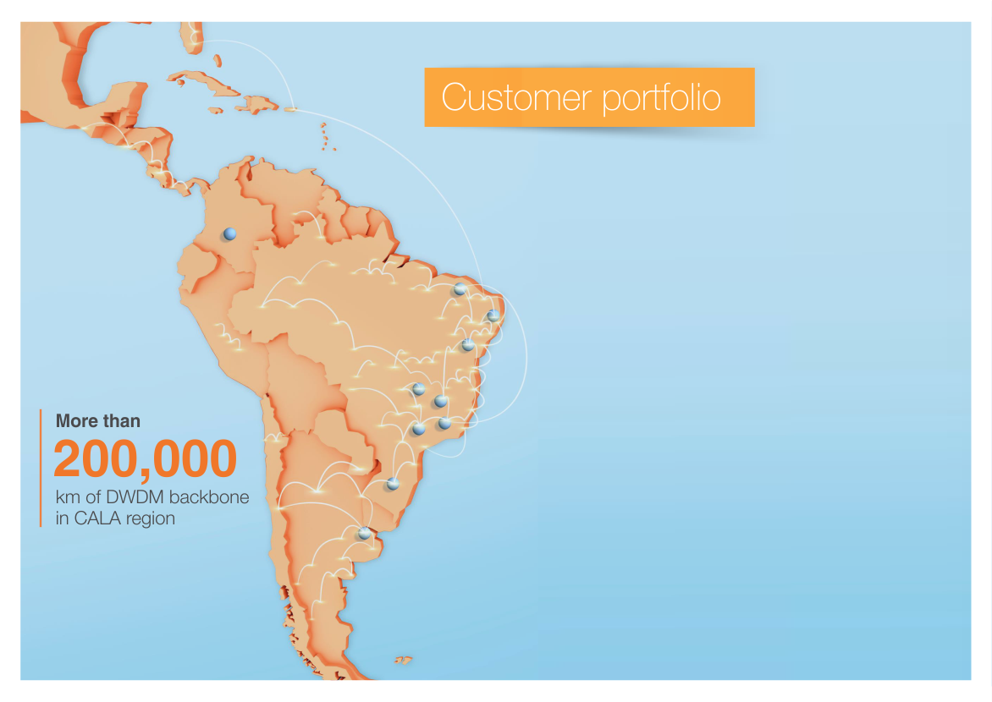
Fixed and mobile service providers
Regional Service
Providers
Carriers of Carriers
Global
carriers
Utilities, Oil&Gas e Integrators
Data Center e Multimedia
Governmental and research institutions

Slide 8
Company Overview: Strategic Location
Renowned university in Latin America in engineering and technology fields
University with importante R&D institute
Manufacturer os electronic produtcs for the technology industry
Viracopos International Airport. One of Latin America’s most developed airports
Largest manufacturer of 3C products in the world
Second largest manufacturer of 3C products
in the world
One of the largest players in the communications equipment industry
Amongst the largest developers and manufactures of technology products in the world
Amongst the largest developers and manufactures of technology products in the world

Slide 11
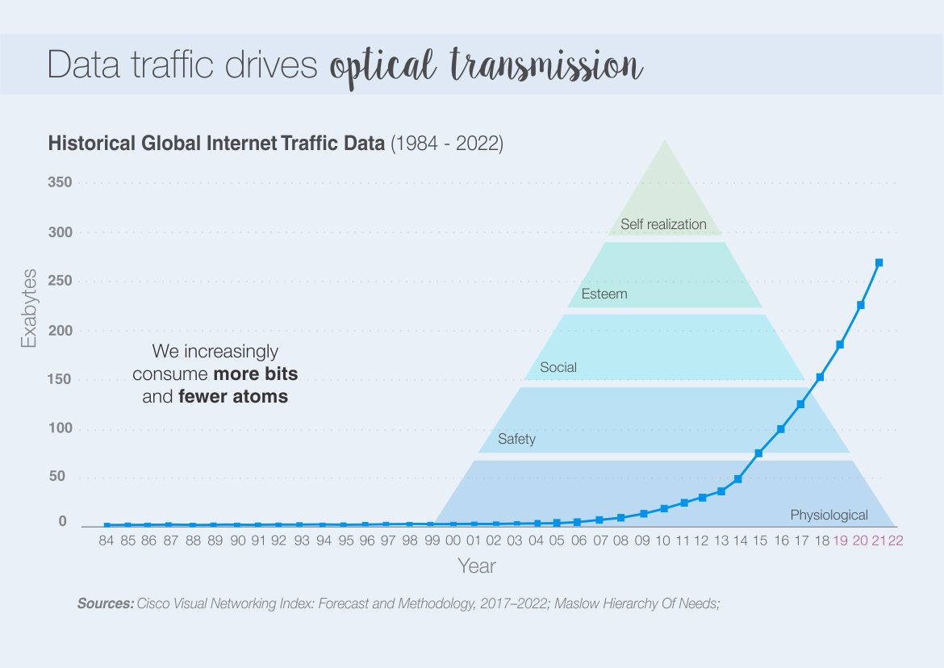

Slide 14
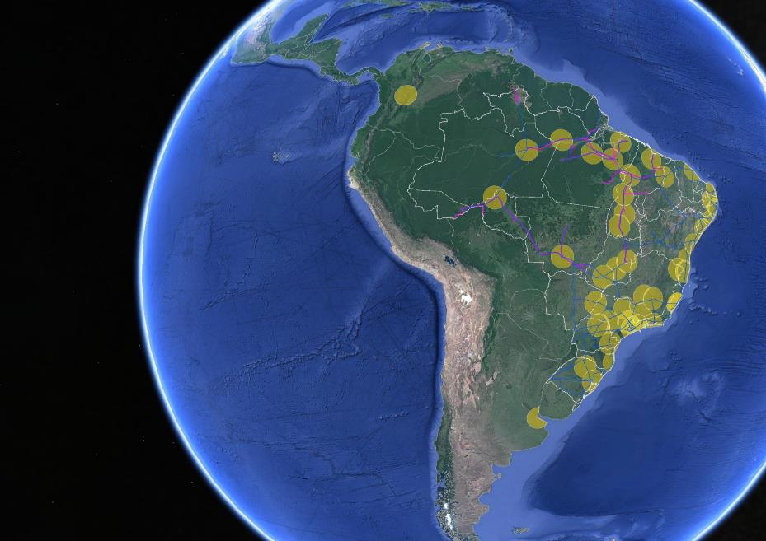

Slide 17
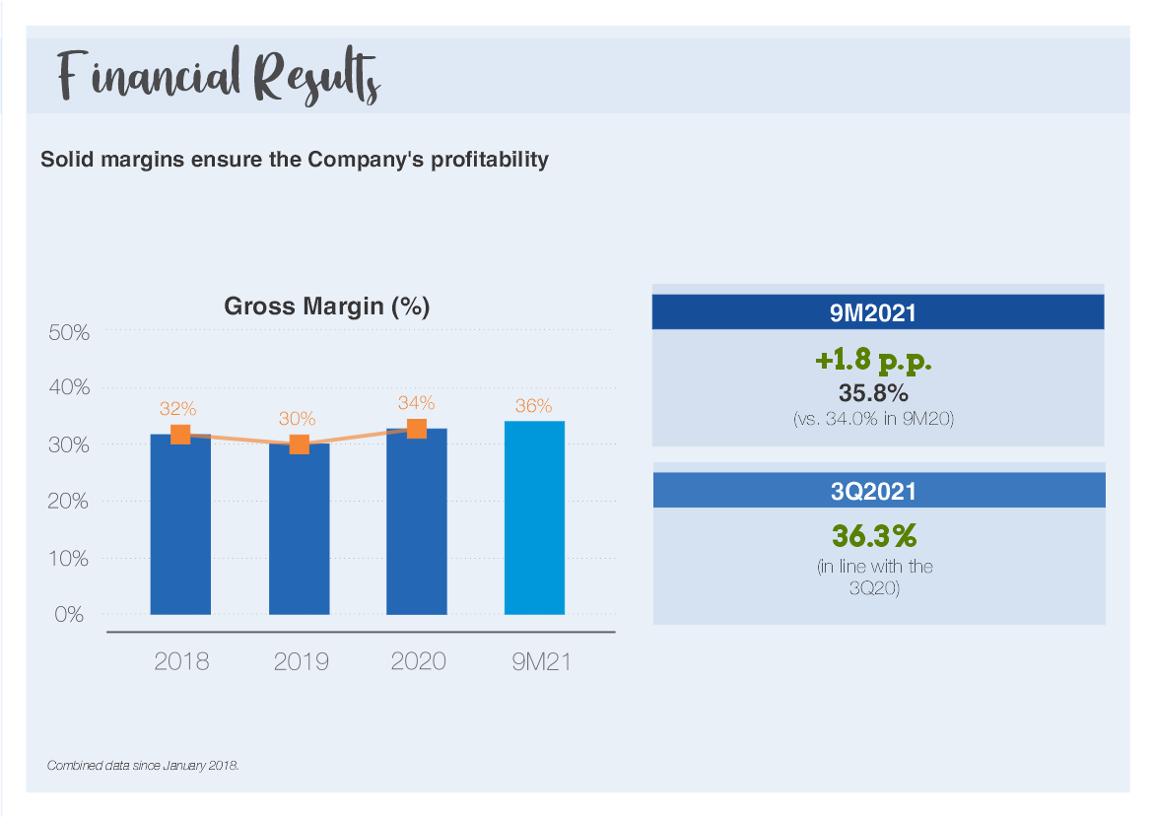

Slide 18
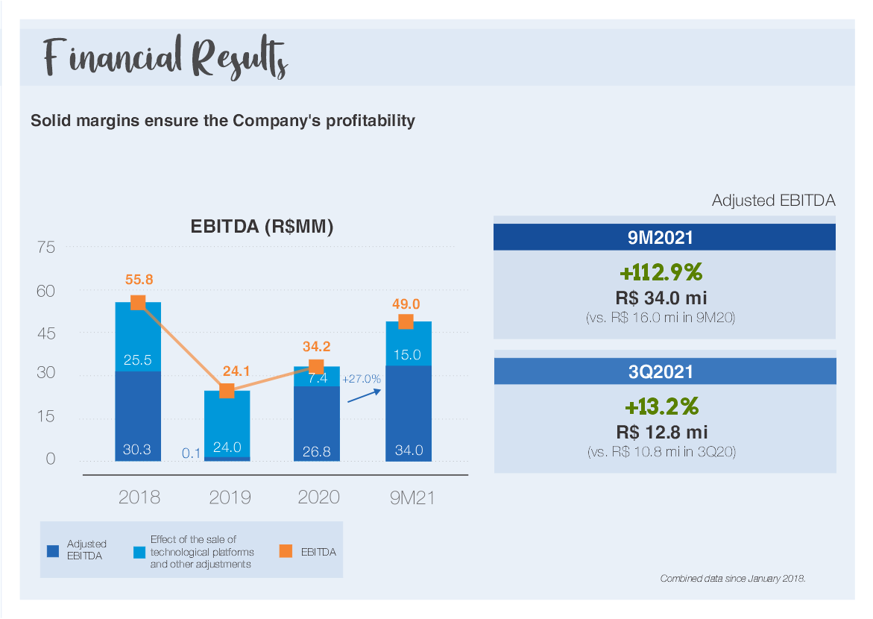

Slide 19
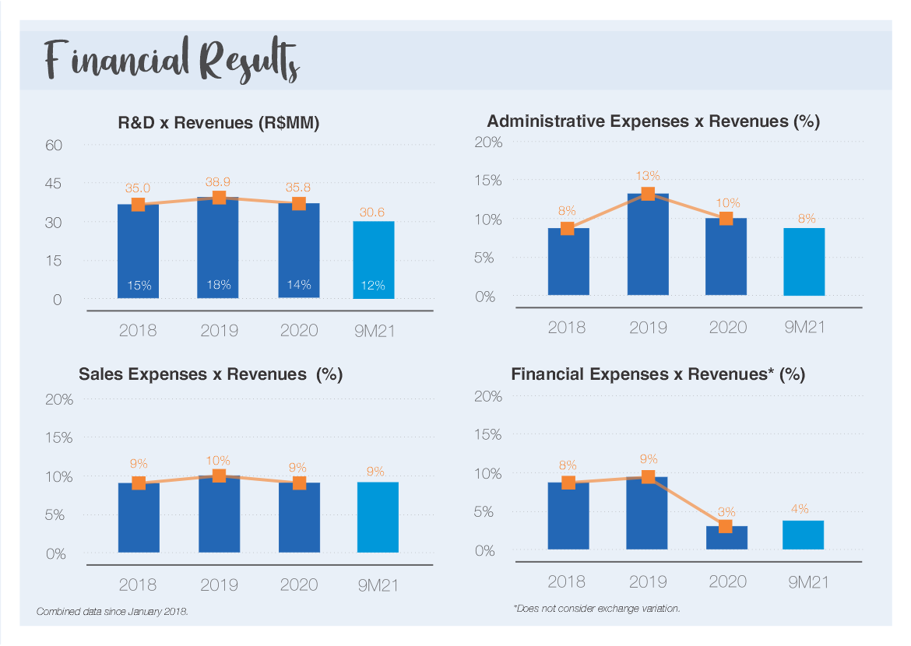

Slide 21
